Slide 1
iSafe Mobile Online Payment System
Ariel Amberden
Kurt Schneider

Slide 2
Why It’s Important
In a recent study, the Diary of Consumer Payment Choice found that 27 percent of all transactions are electronic and roughly 11 percent of these transactions are done on mobile devices. This trend will only continue to grow.
J. Gold Associates Research Report notes that, "organizations lost an average of $92.3 million due to fraudulent mobile transactions for a 3% loss of total revenue per year.”
Customers want assurance that mobile transactions are as secure as traditional electronic transactions.
With these facts in mind, mobile security will continue to be an important issue in the foreseeable future.

Slide 3
Security Concerns
Protect against adversaries with the most current high-end computers.
Adversaries knowledge is limited to cipher text only and known plain text.
Attacks include eavesdropping, denial of service attacks and SQL injection attacks.

Slide 4
Solutions
Closely follow ApplePay and EMV Payment Tokenization.
Client and server connections to use OpenSSL TSL protocol.
Payment Tokens are surrogate values that replace the Primary Account Number (PAN) and may be used to originate payment transactions in place of the PAN. Each payment token use is limited to one merchant.
Payment Tokens are 13-19 digit numeric value that must pass the same basic account number rules as a PAN. In other words, a Payment Token will be indistinguishable from a PAN.

Slide 5
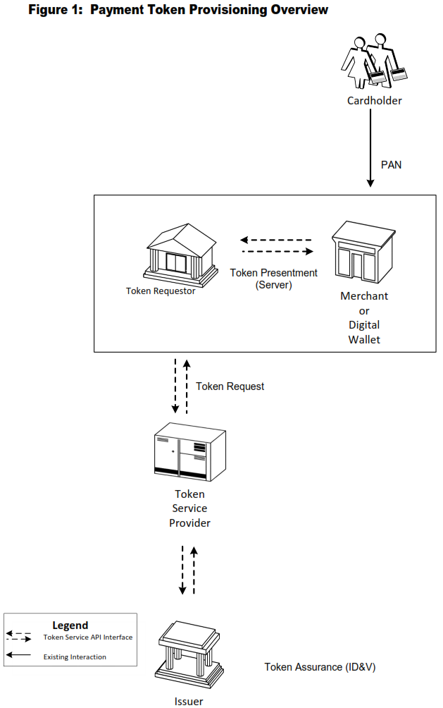
Payment Token Provision

Slide 6
Classes
Customer or Merchant (client)
Acquiring Bank (server)
Acts as the Token Requester on behalf of the merchant. Transaction information is received from the merchant and sent to the Issuing Bank for approval.
Issuing Bank (server)
Approves or declines a transaction based the on the customers existing funds.

Slide 7
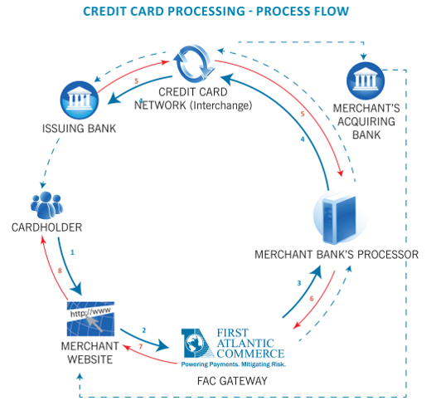
Transaction Process

Slide 8
Issuing Bank
Issuer (MySQL server module 1)
Description: mimic card issuers, for our purposes will only record transactions, pre-load with dummy cardholders.
Functions: CRUD (create, retrieve, update, delete) for transactions table.
Data: token data, customer and merchant ids, amount.

Slide 9
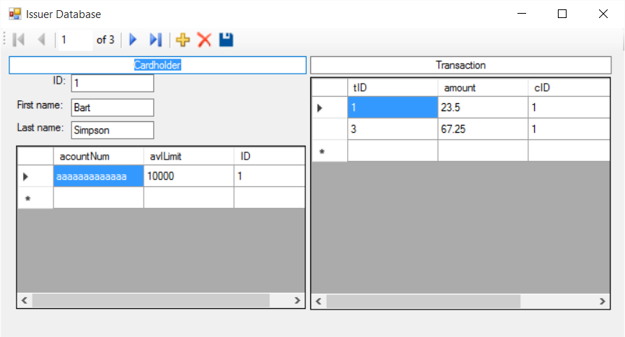
Issuing Bank

Slide 10
Acquiring Bank
Acquirer (server module 2)
Description: simulates software run by a bank, credit union, etc., must be pre-loaded with dummy accounts for testing purposes since we cannot connect to a real bank system.
Functions: authorize, capture, clearing, and exception processing, approve payment.
Data: table of all data collected from iSafe app, table recording transactions: merchant/customer ids, amount, date, and token data.
Request payment tokens from the Token Service Provider.

Slide 11
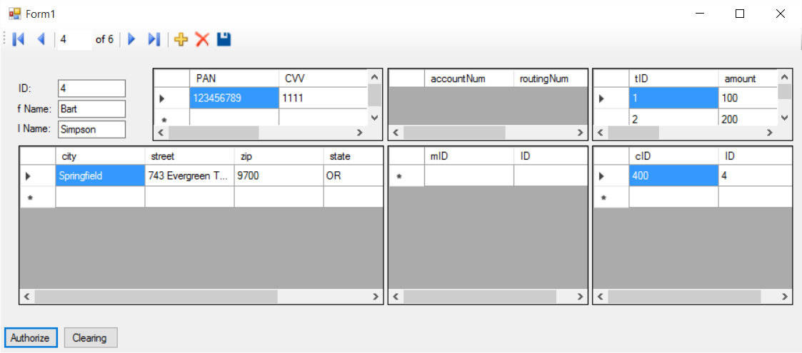
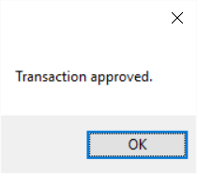
Acquiring Bank

Slide 12
Resources
http://www.frbsf.org/cash/files/FedNotes_Evidence_from_DCPC.pdf
http://www.emc.com/collateral/analyst-reports/h13939-mobile-e-commerce-friend-or-foe.pdf
http://blog.cryptographyengineering.com/2015_09_01_archive.html
EMV Payment Tokenization Specification, Technical Framework Version 1.0, March 2014, page 13.

